Slide 1
An Opinionated Approach to ASP.NET Core
(50 opinions, to be exact)
K. Scott Allen
@OdeToCode

Slide 2
Solutions and Projects
Controllers
C# Code
Views
Startup
Client Code
Tests

Slide 3

Solutions & Projects
3

Slide 4
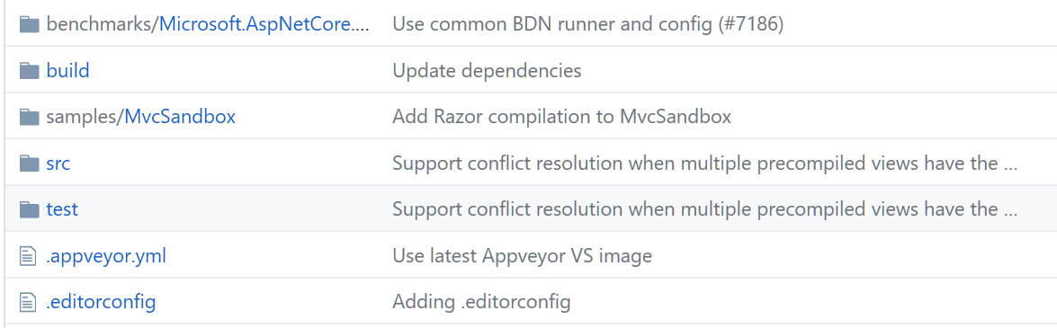
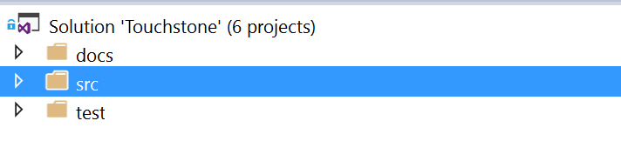
Use a Standard Repo Structure

Slide 5
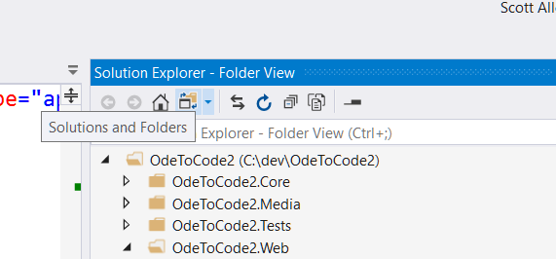
Use Folder View

Slide 6
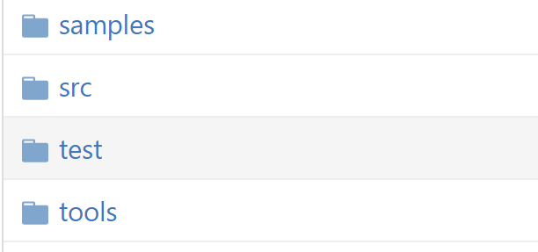
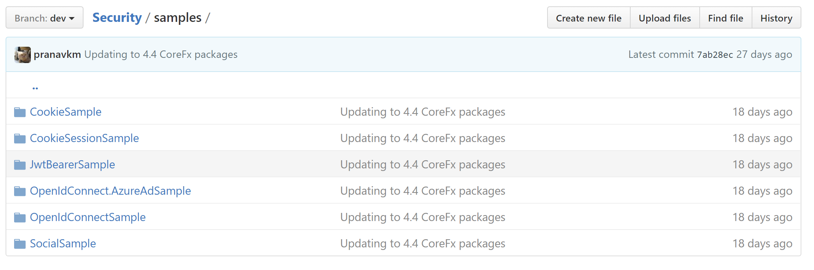
Include Samples & Tools

Slide 7
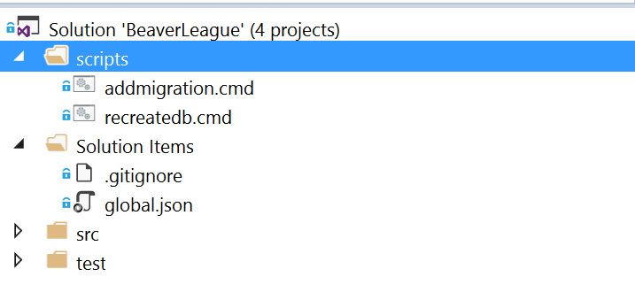
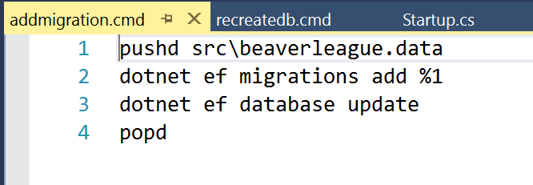
Include Development Scripts

Slide 8
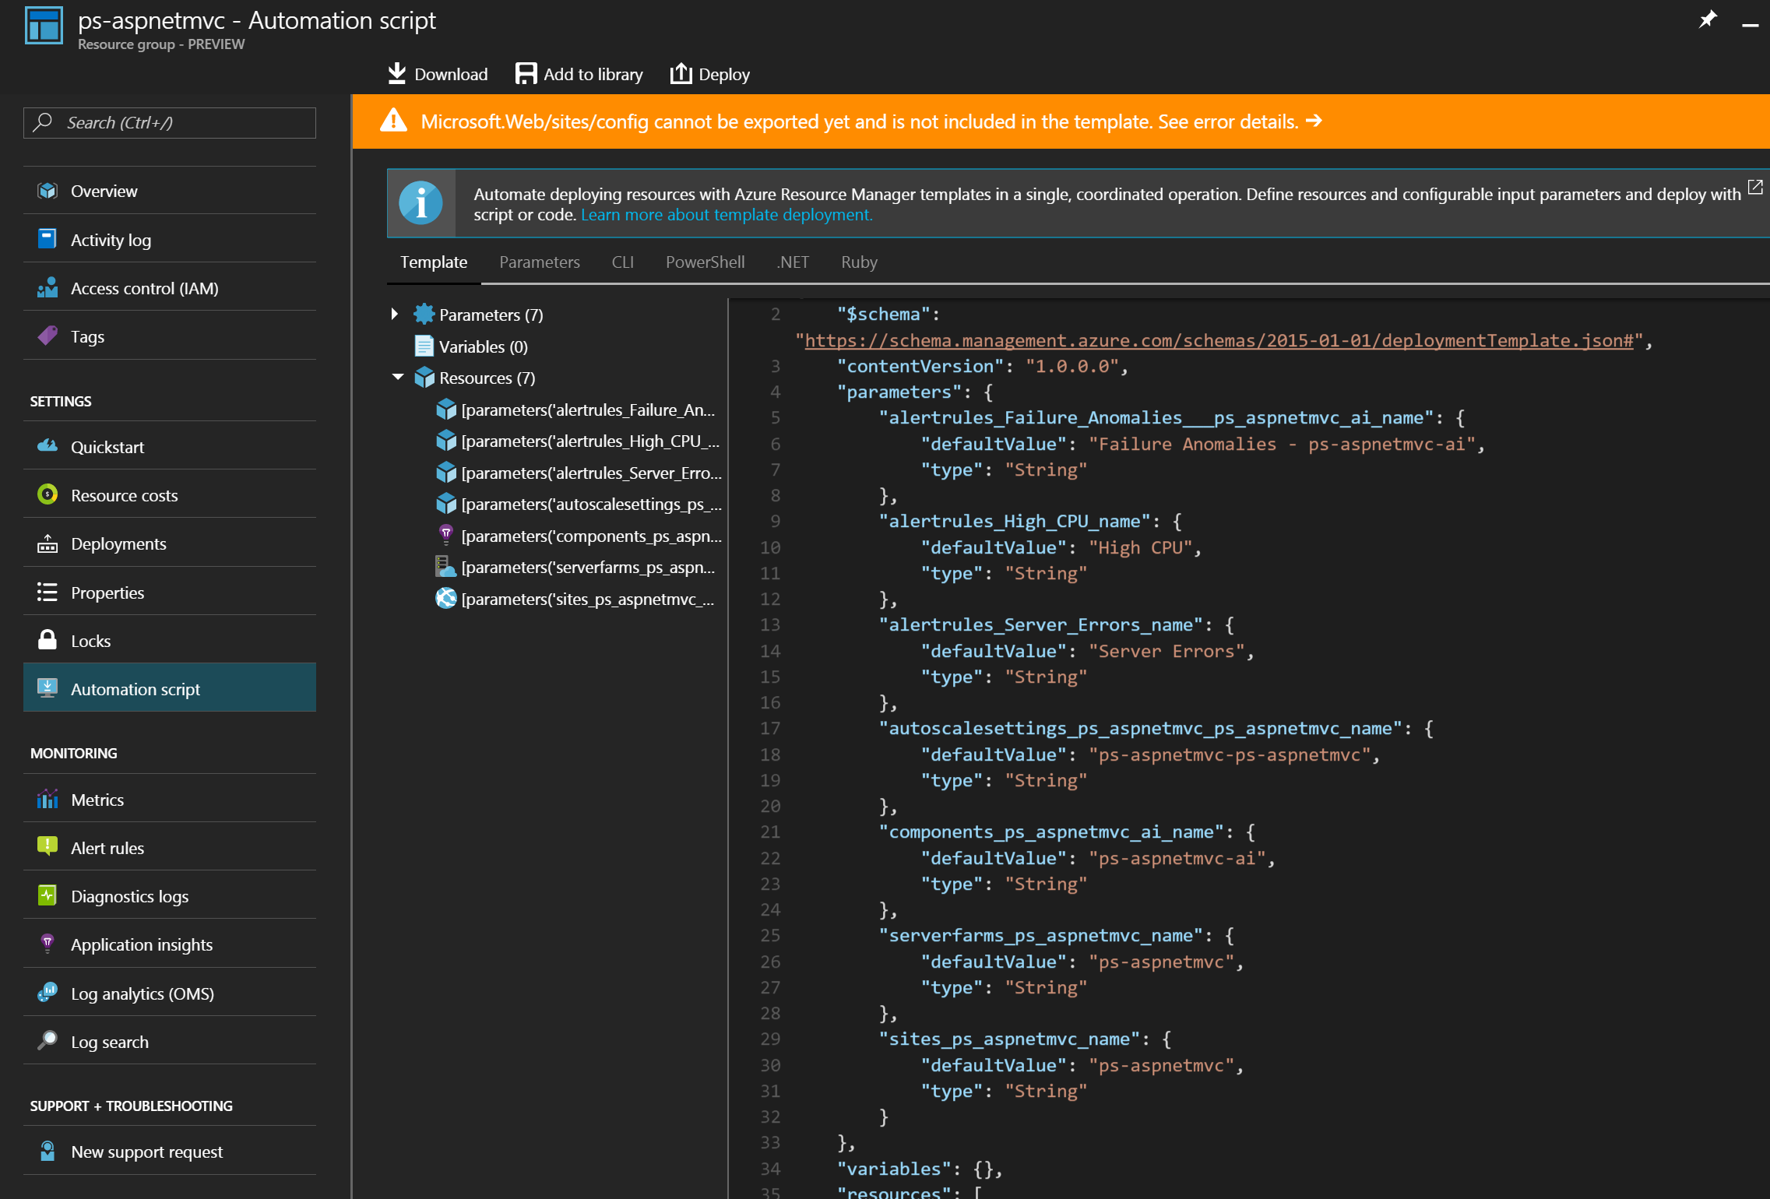
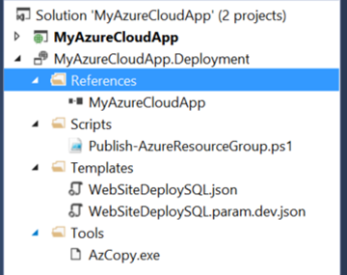
Include Deployment Scripts & Templates

Slide 9
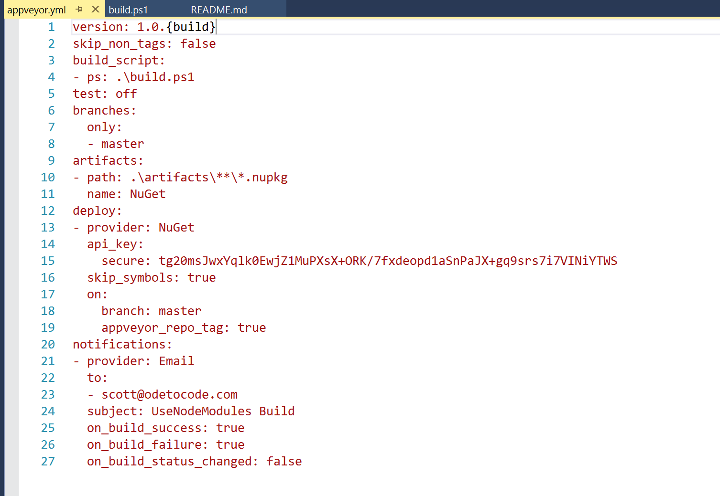
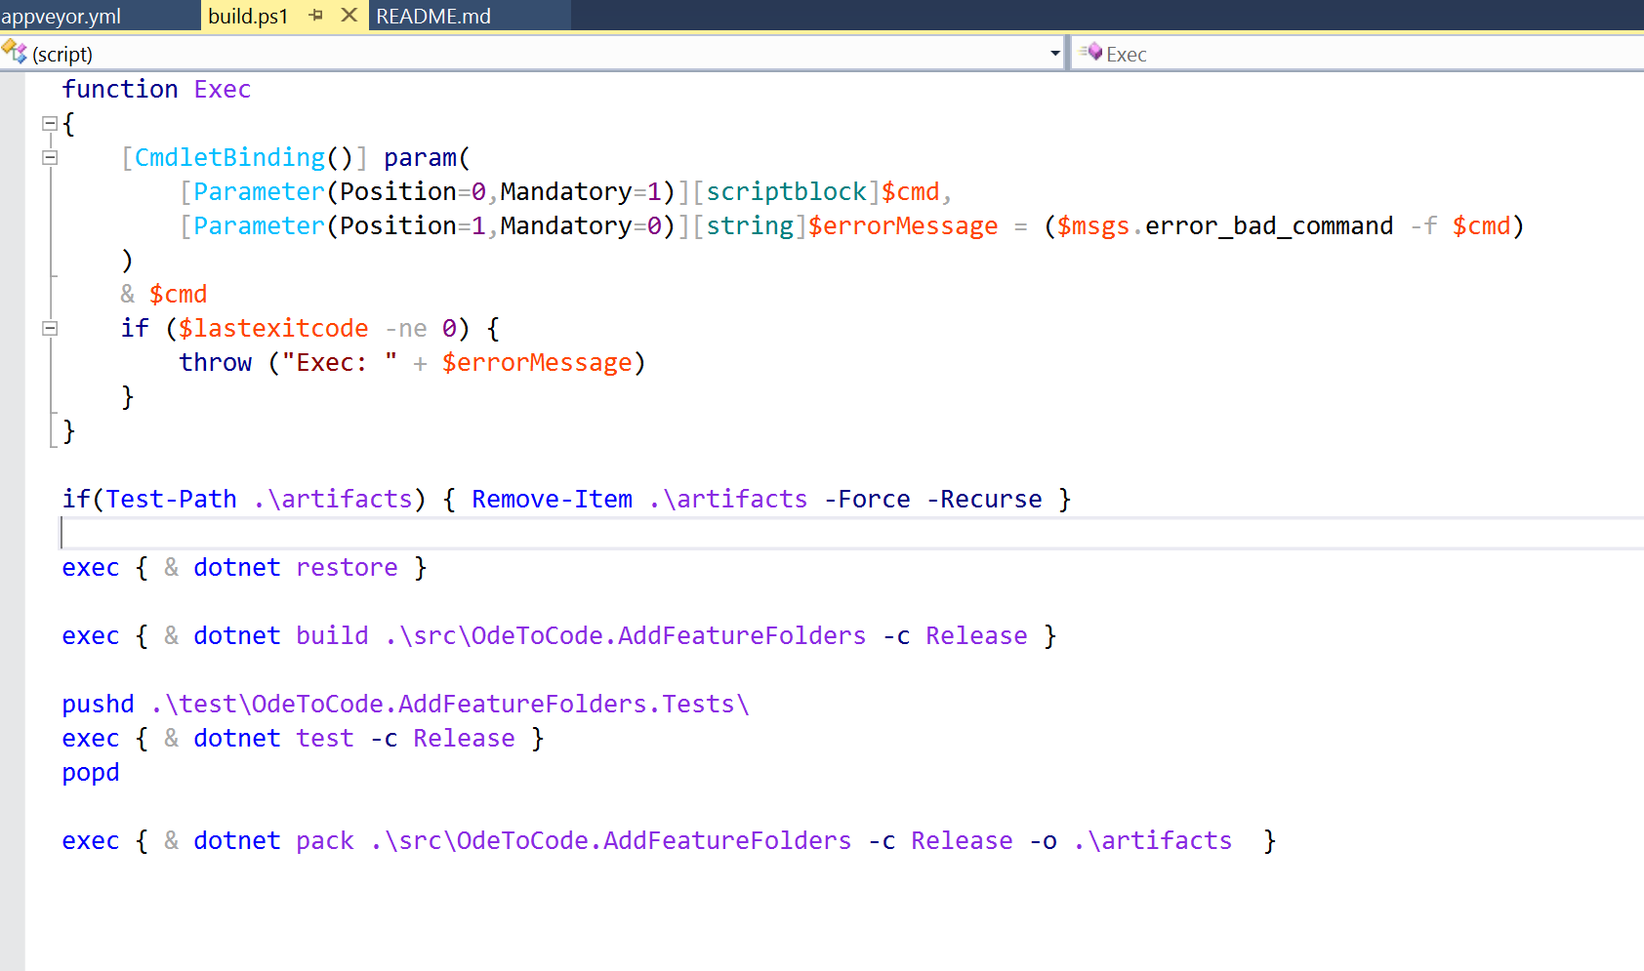
Use AppVeyor YAML for Builds Instead of UI

Slide 10
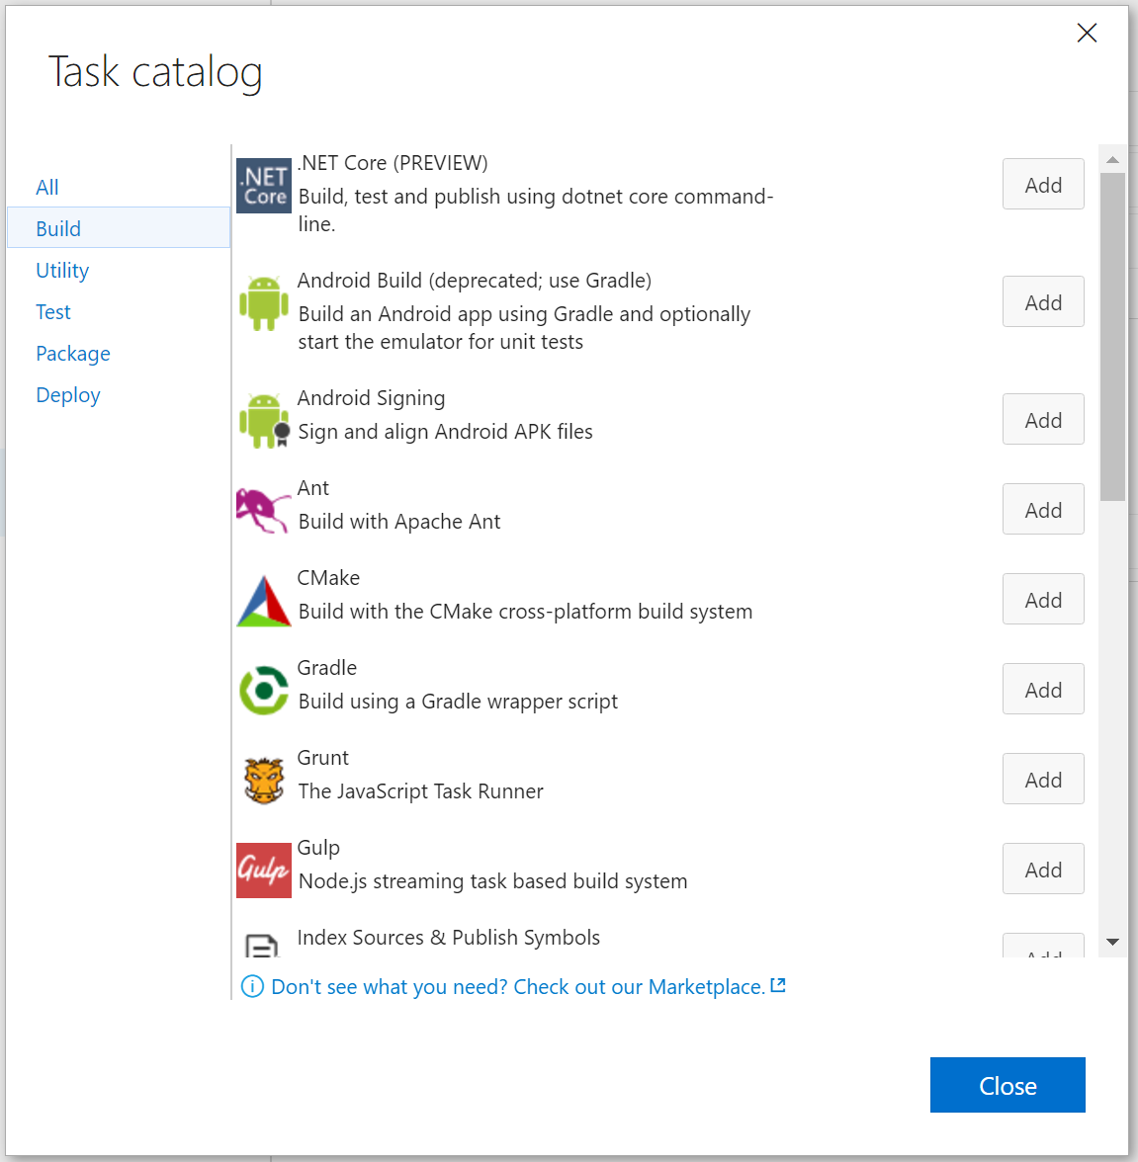
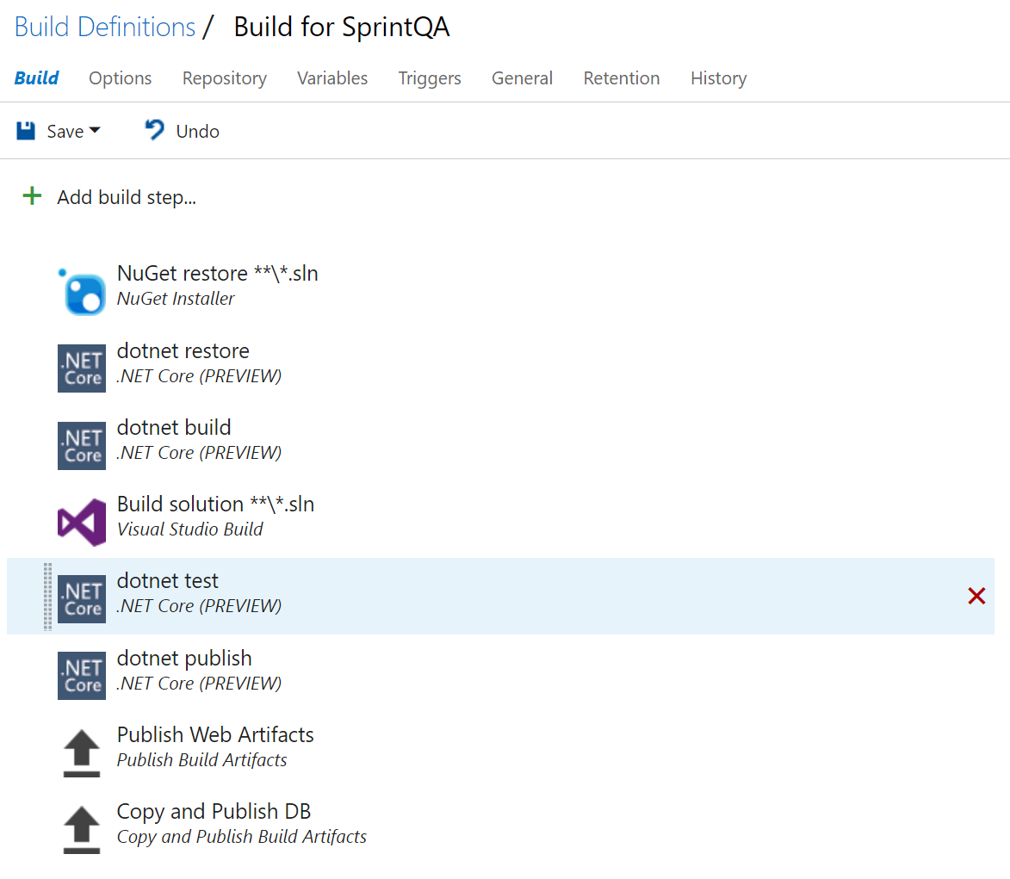
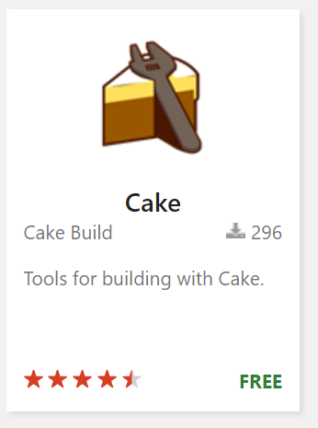
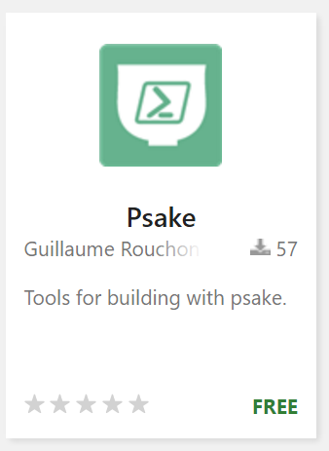
Use YAML for VSO Builds (and Releases!)

Slide 11

Startup
11

Slide 12
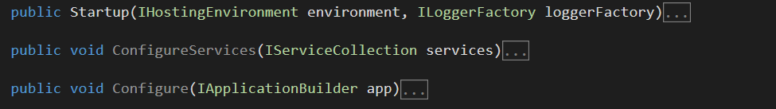
Only Use Startup for Services and Middleware
Three responsibilities

Slide 13
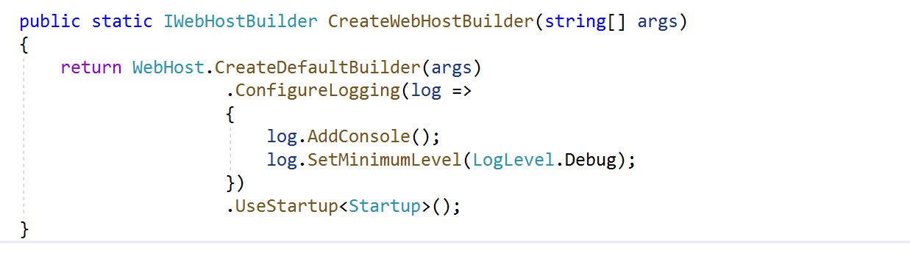
Logger Is Configured Before Middleware
Leave Configure for middleware only

Slide 14
Use IOptions instead of IConfiguration

Slide 15
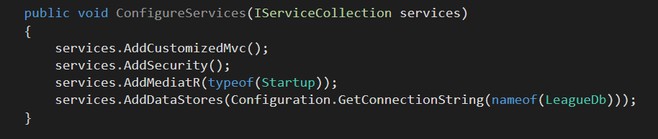
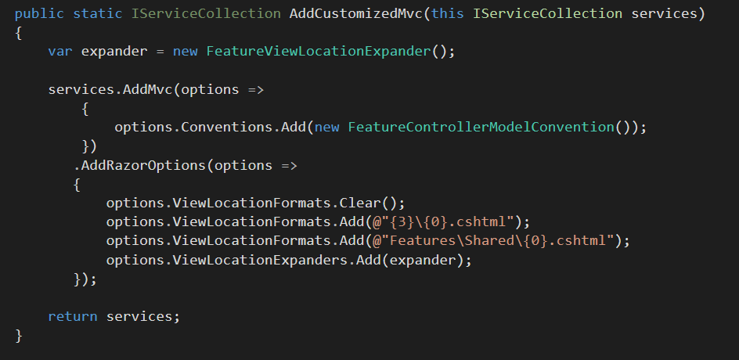
Keep Configure Methods Clean

Slide 16
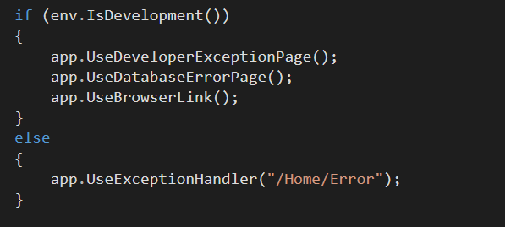
Configure Is Allowed To Branch

Slide 17
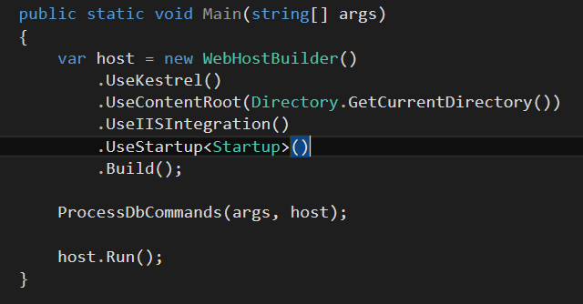
Make Use Of Your App As Executable

Slide 18
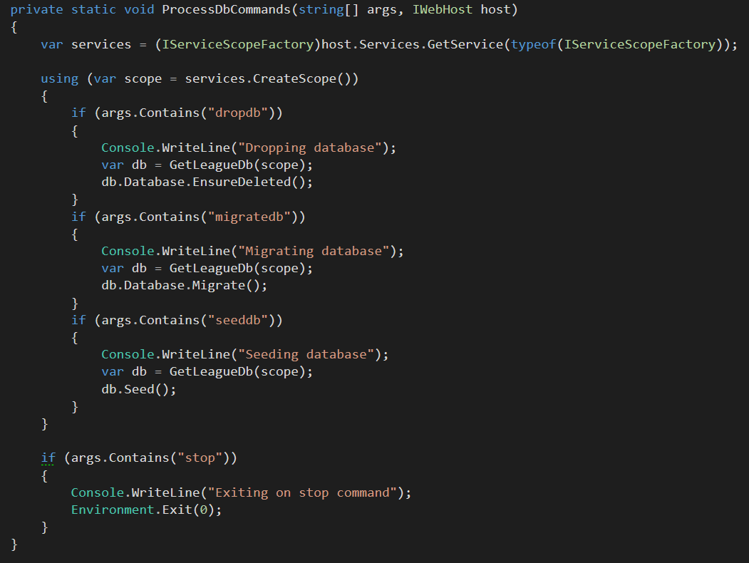
Always Use IServiceScopeFactory During Startup

Slide 19
Use DbContextPools

Slide 20
Use HttpClientFactory

Slide 21
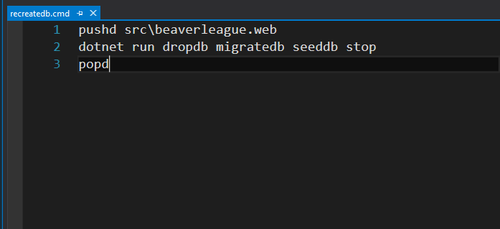
Add Scripts To Make Startup Parameters Easy

Slide 22

Project
Structure
21

Slide 23
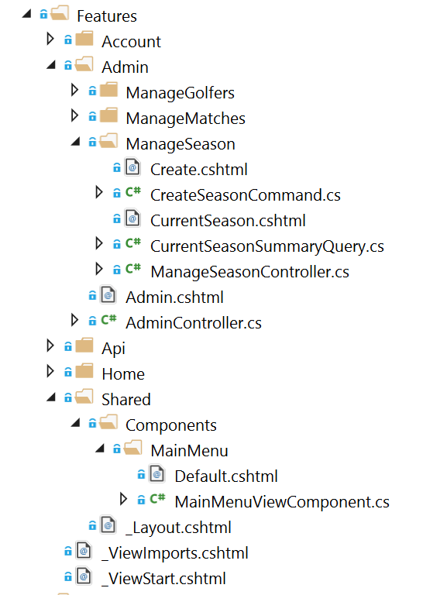
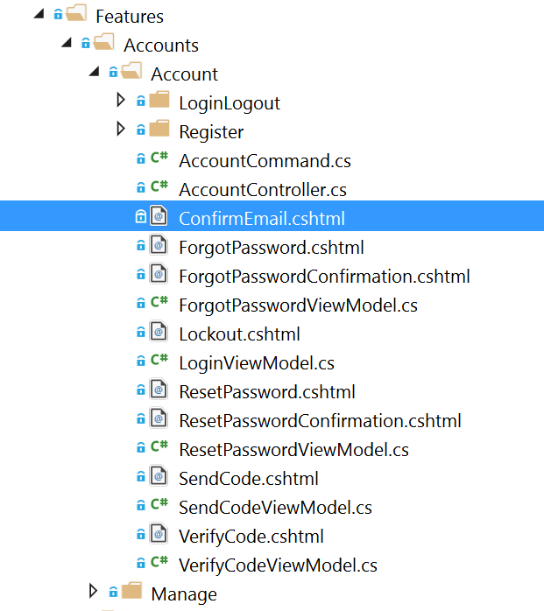
Feature Folders

Slide 24
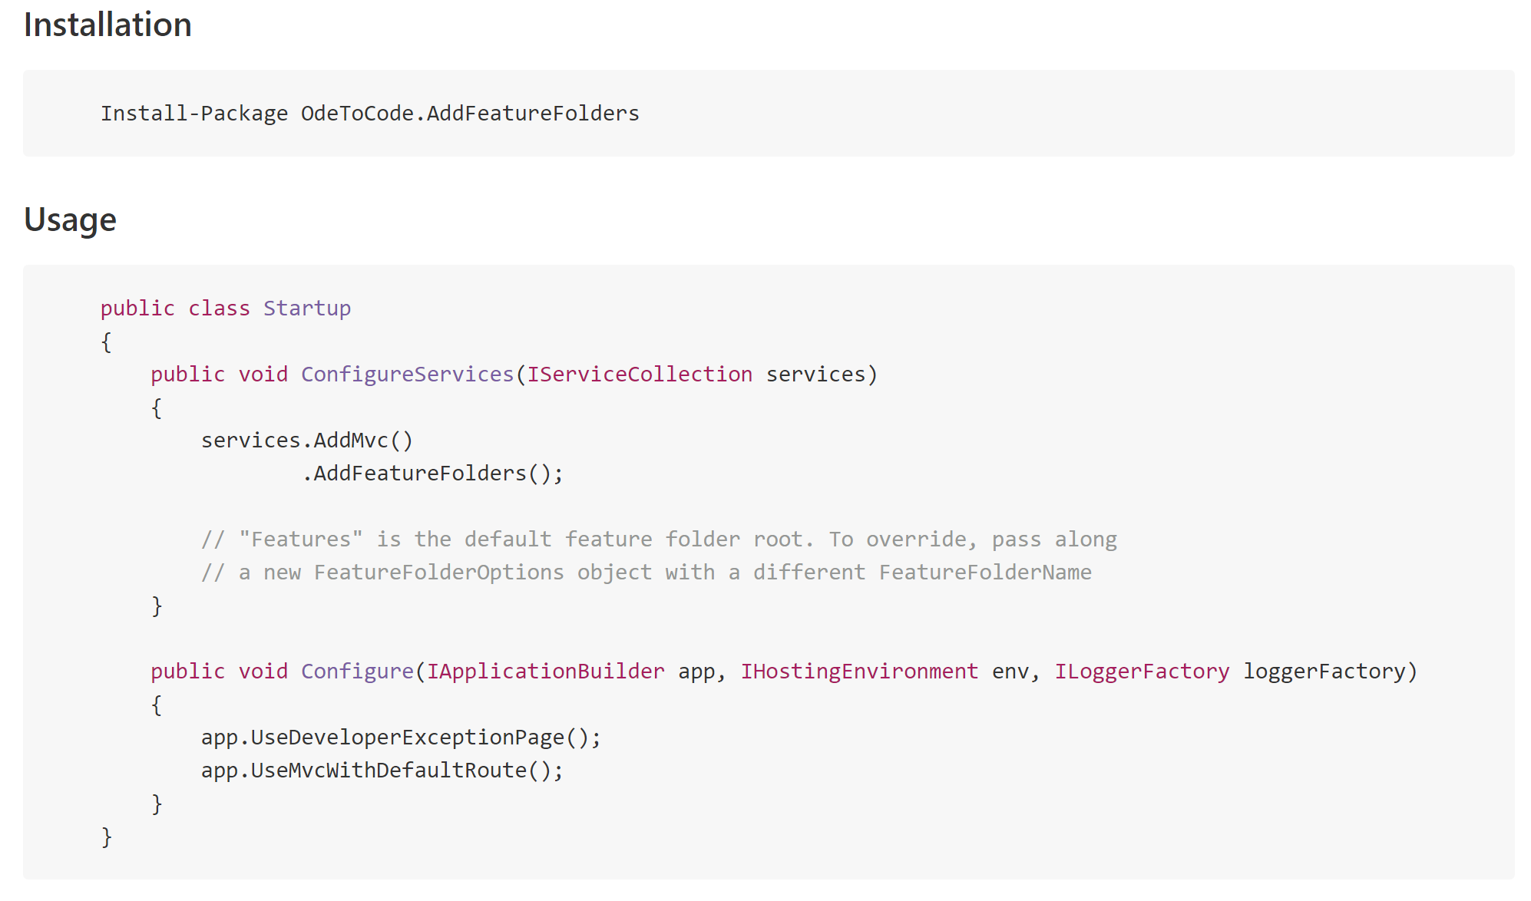
Feature Folders Are Easy

Slide 25
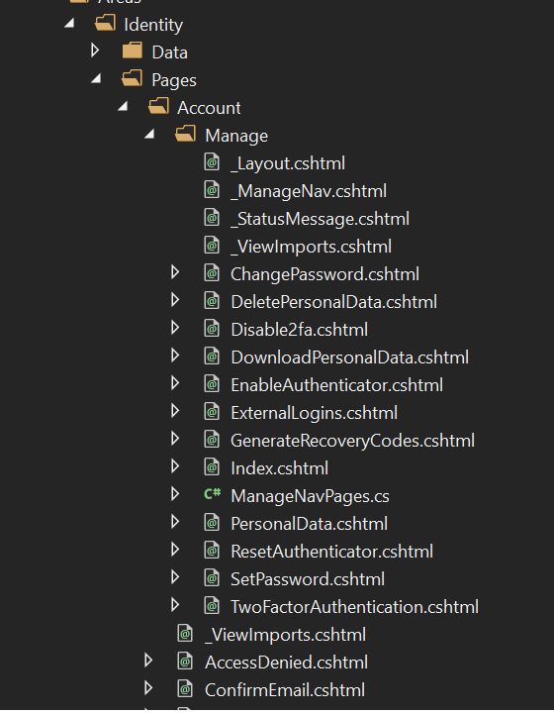
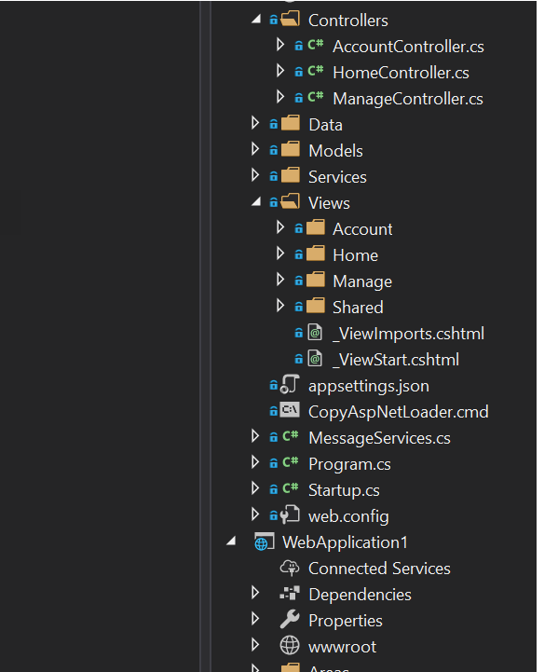
Identity Razor Pages
Identity MVC

Slide 26
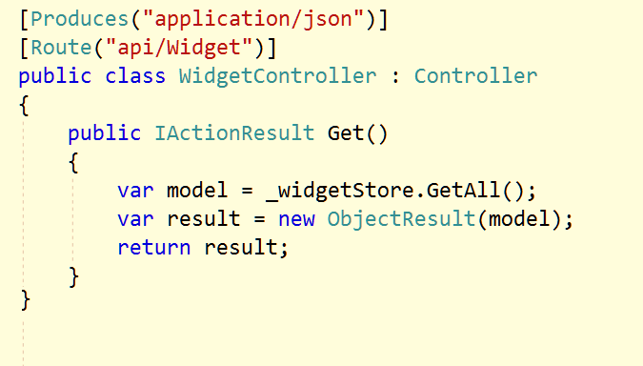
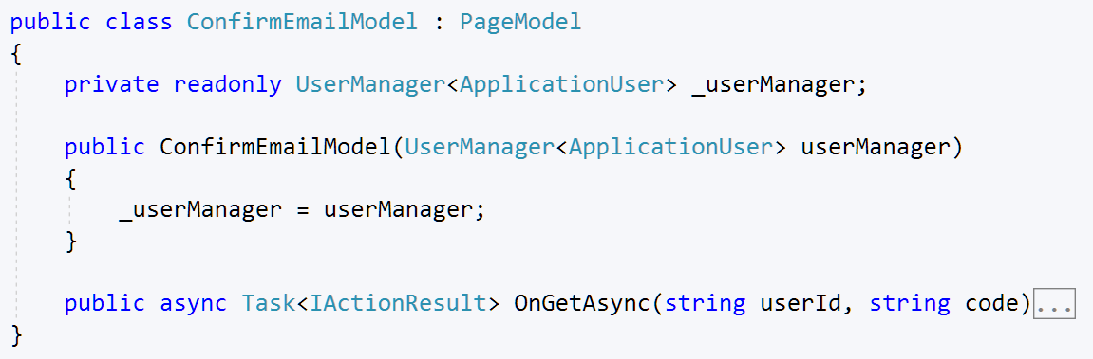
Controllers for APIs / Razor Pages for HTML

Slide 27

Controllers for Open APIs, gRPC for closed APIs

Slide 28

Controllers
24

Slide 29
Always Inject Dependencies

Slide 30
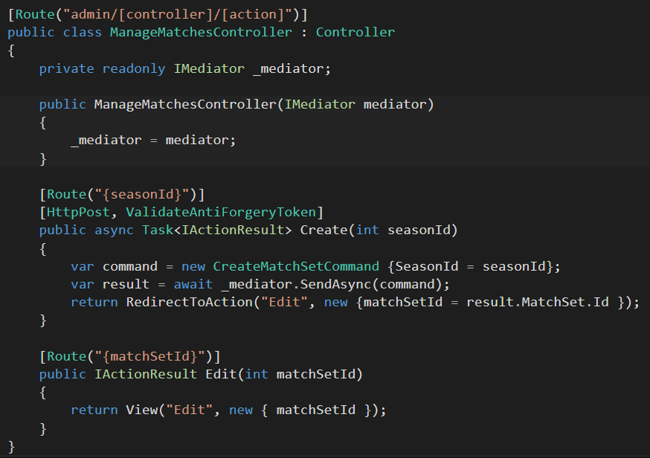
Route using [Route]

Slide 31
Use Swagger

Slide 32
Use APIController

Slide 33
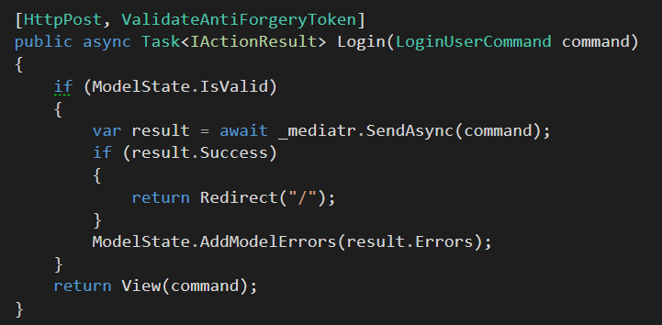
Think About Mediatr

Slide 34
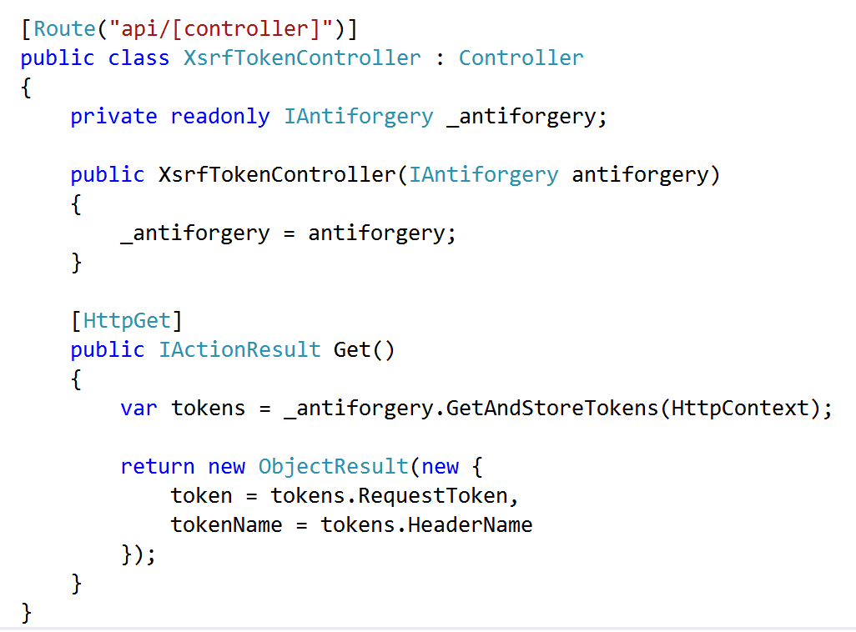
Don’t Forget XSRF in APIs

Slide 35
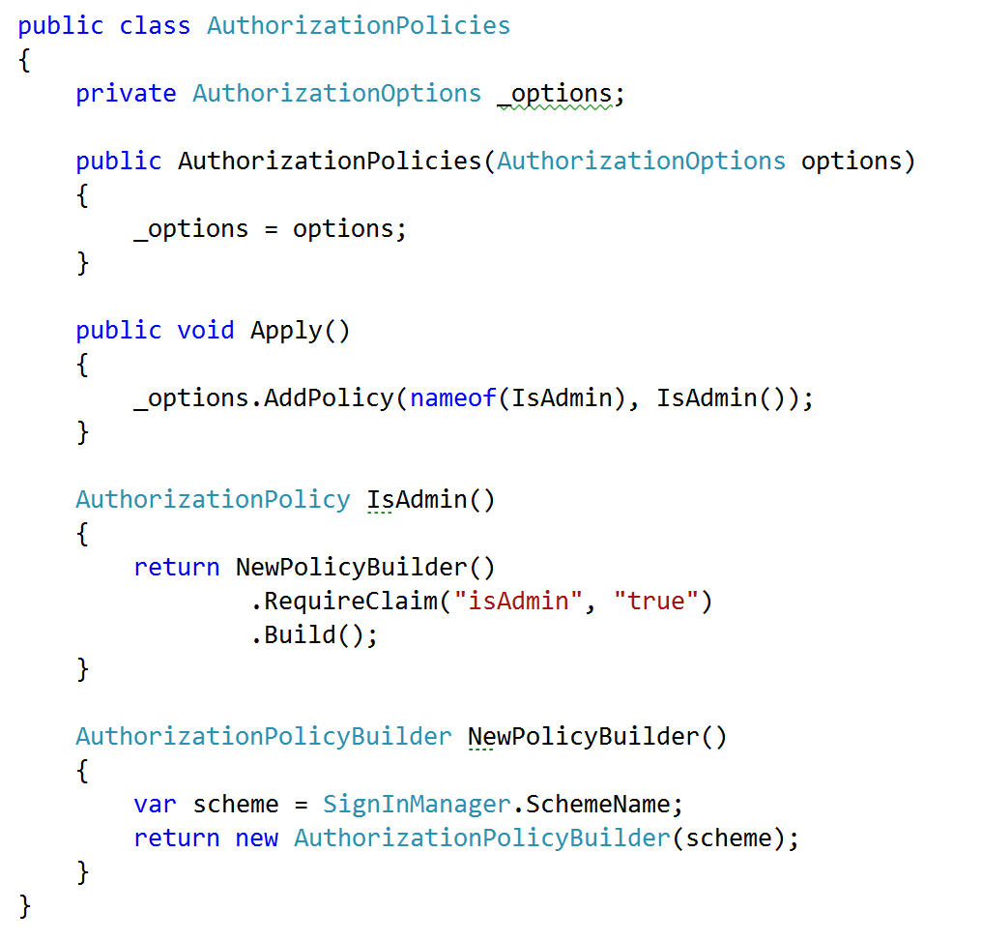
Embrace Security Policies

Slide 36
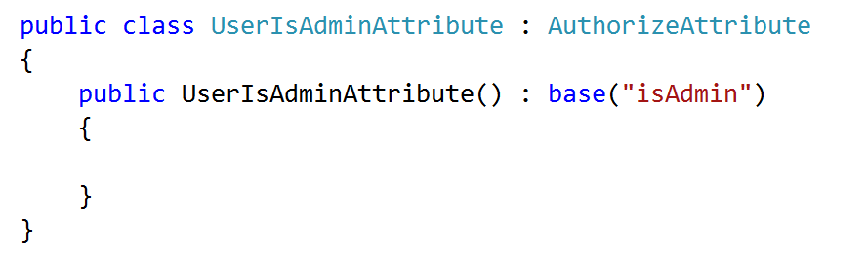
Create Custom Authorize Attributes

Slide 37

Views
32

Slide 38
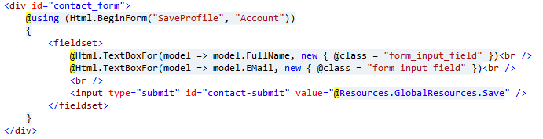
Avoid HTML Helpers

Slide 39
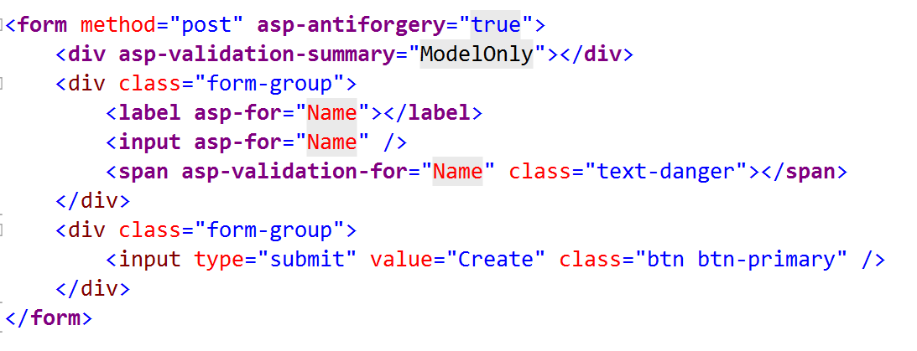
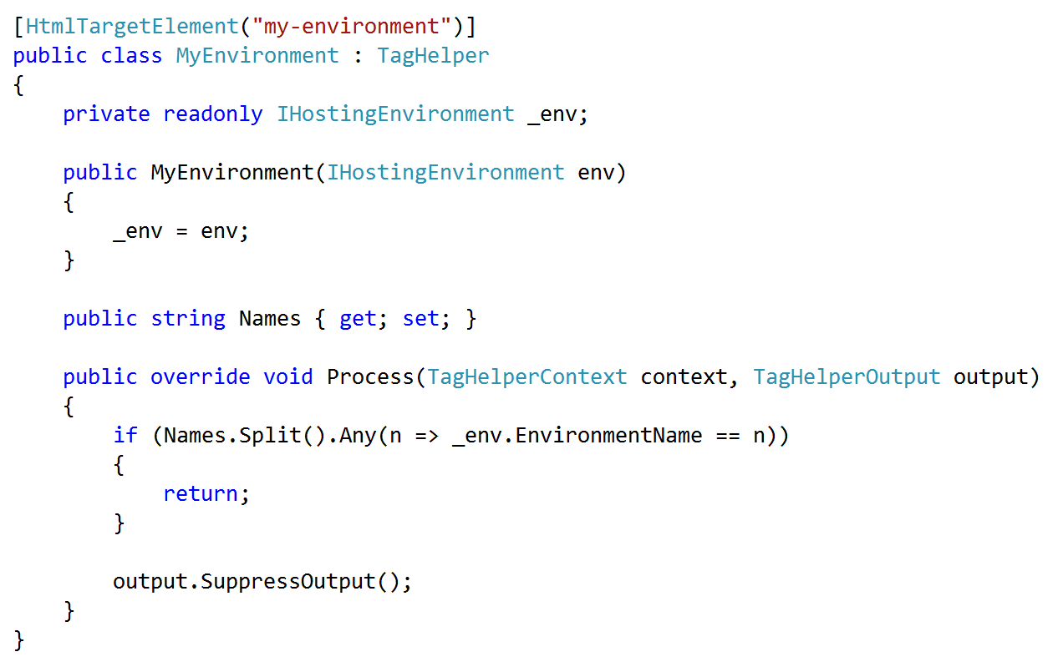
Embrace & Extend Tag Helpers

Slide 40
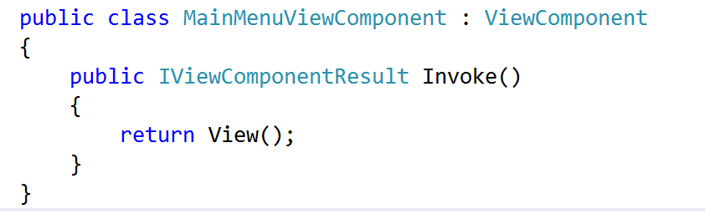
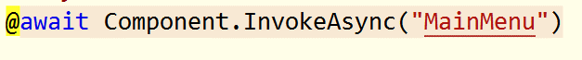
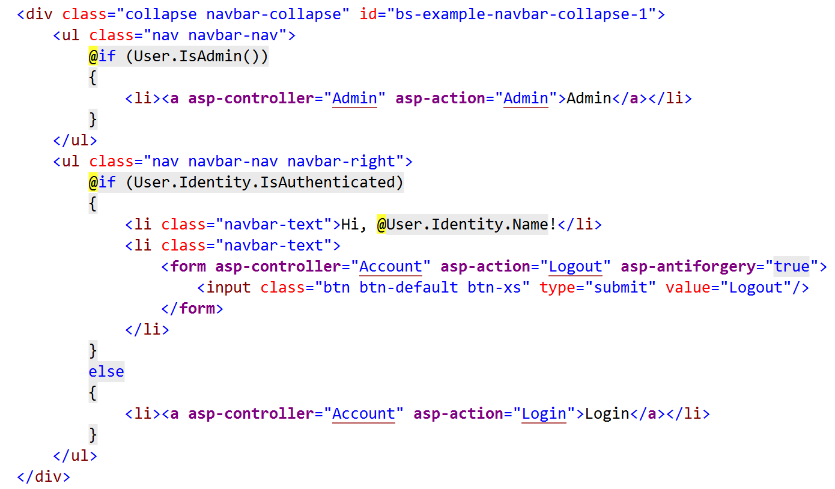
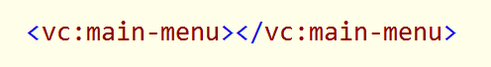
Embrace View Components

Slide 41

Data
36

Slide 42
Use Query Classes

Slide 43
Think About Event Sourcing

Slide 44
Think About CQRS

Slide 45
Client Code
36

Slide 46
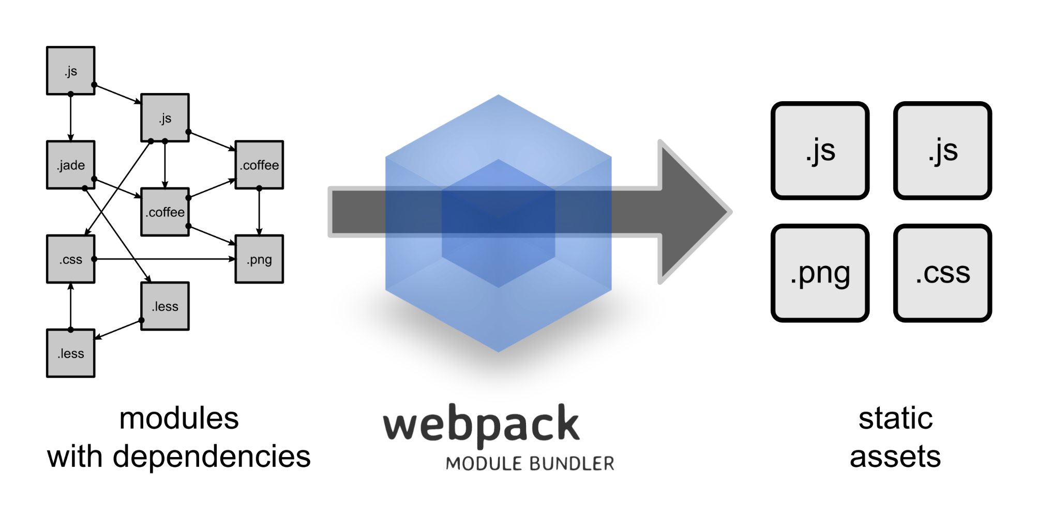
Use WebPack

Slide 47
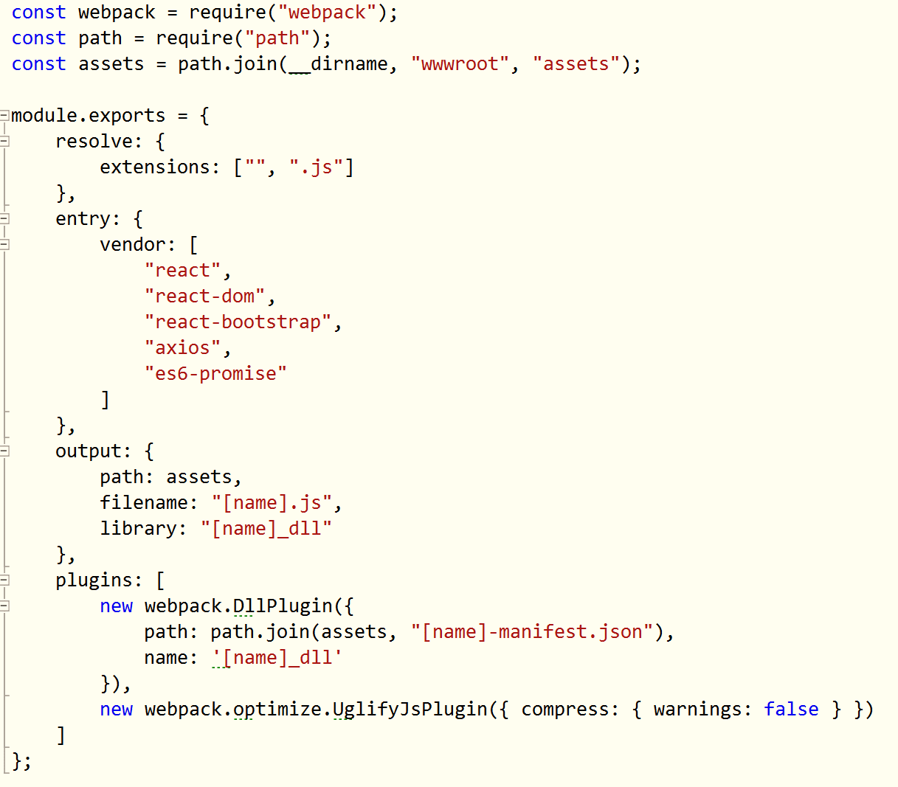
Use WebPack

Slide 48
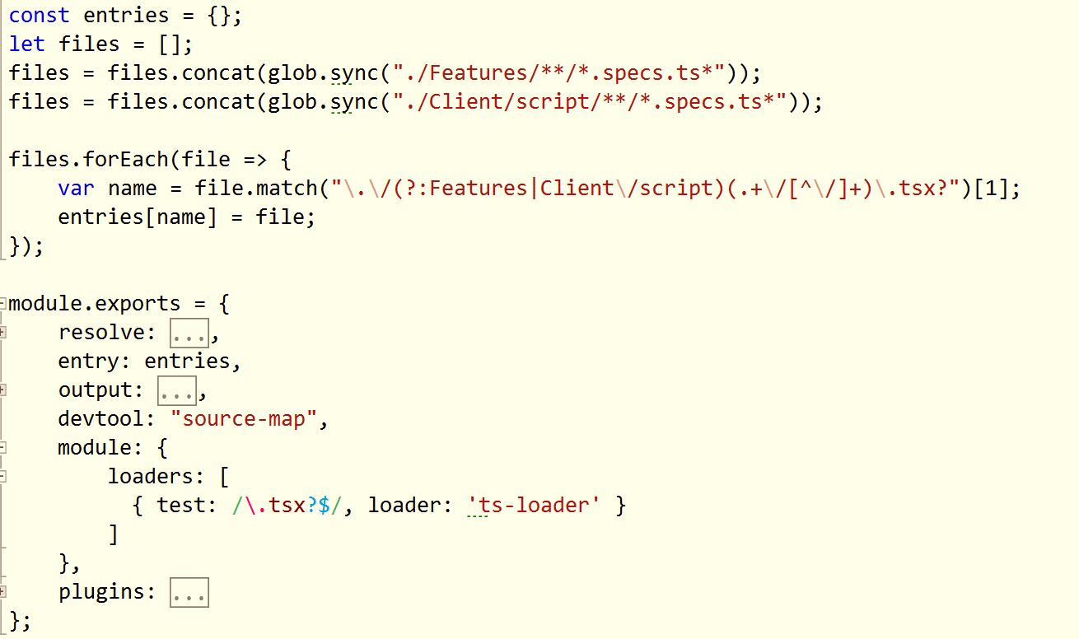
Use Multiple Configuration Files

Slide 49
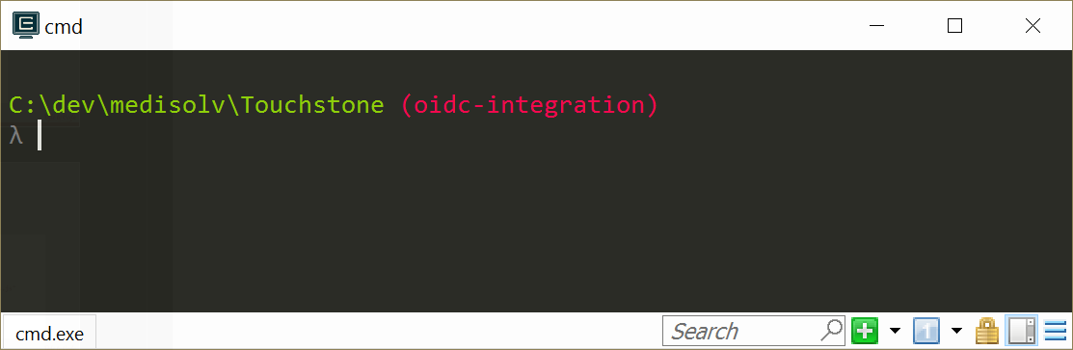
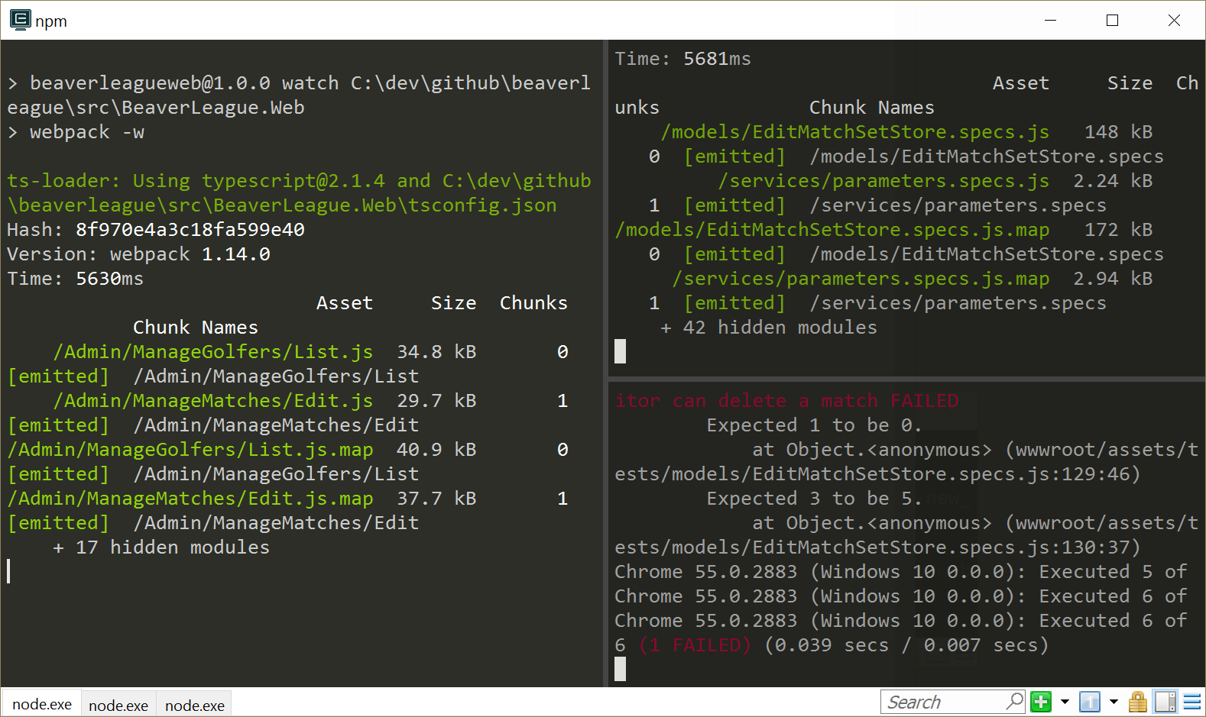
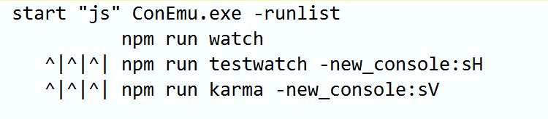
Use ConEmu or cmder

Slide 50
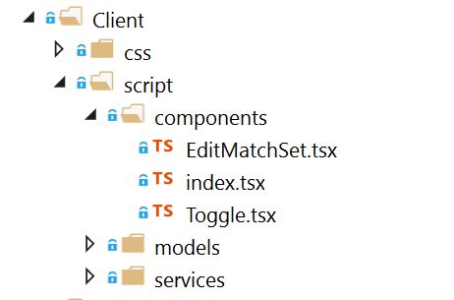
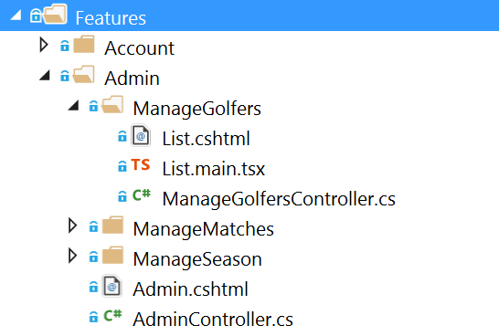
Client Code Layout

Slide 51

NuGet and npm Only

Slide 52


Use TypeScript

Slide 53

Use Visual Studio Code for TypeScript and ES2015+

Slide 54

wwwroot is your bin\ folder

Slide 55

Testing
50

Slide 56
A Single Test Project Is Not A Bad Idea
Web
Test
-
Web
Core
BEE
Core
BEE
(background
execution engine)

Slide 57


Use xUnit
Extensible, flexible, open source
Low ceremony
Good vocabulary

Slide 58







Try Hard to Avoid Mocks

Slide 59

Use the Microsoft.AspNetCore.Mvc.Testing

Slide 60

Define a Factory

Slide 61

More Integration Tests & Fewer Unit Tests

Slide 62

Make Integration Tests Easy

Slide 63

Make Use of AngleSharp

Slide 64

C#
Code
58

Slide 65
Use Non-Nullable Reference Types

Slide 66

Use Environment.NewLine

Slide 67

Use Path.Combine

Slide 68

Be Aware of Environment Variables

Slide 69


Don’t Use the Async Suffix

Slide 70



Thanks!
scott@OdeToCode.com

